Slide 1
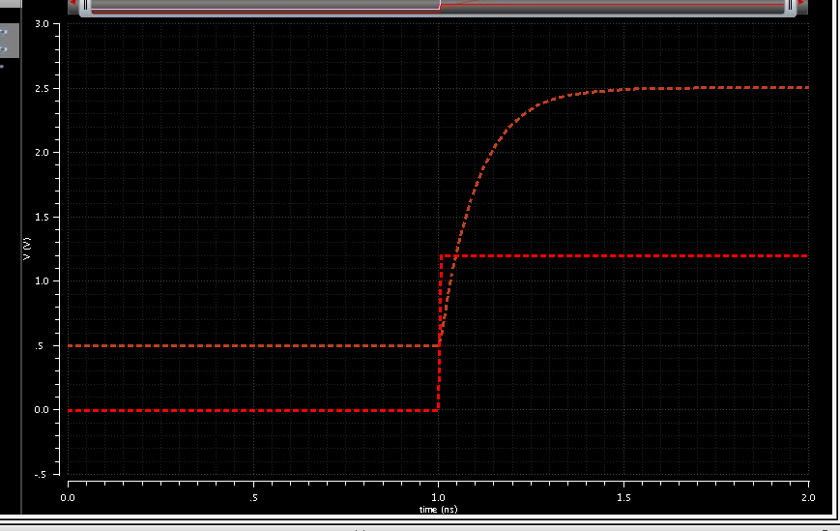
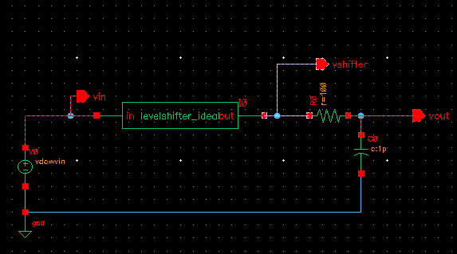
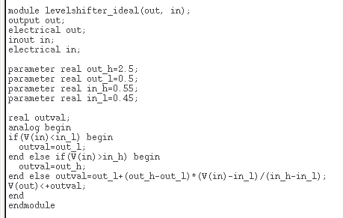
Level shifter
Planning:
21/11: Initial design of level shifter
17/11: Fully simulated design of level shifter

